Slide 1

JavaScript 102
The Very Basics

Slide 2

Prep for class
Complete Treehouse Javascript Basics lesson: https://teamtreehouse.com/library/javascript-basics [381 min]
Introduction to JavaScript
Storing and Tracking Information with Variables
Creating Reusable Code with Functions

Slide 3

Today’s Topics
Where does JavaScript fit?
Naming Variables and Functions
Function Basics
Selecting the DOM
Manipulating the DOM

Slide 4

Where does JavaScript Fit?
Understanding the pieces.

Slide 5
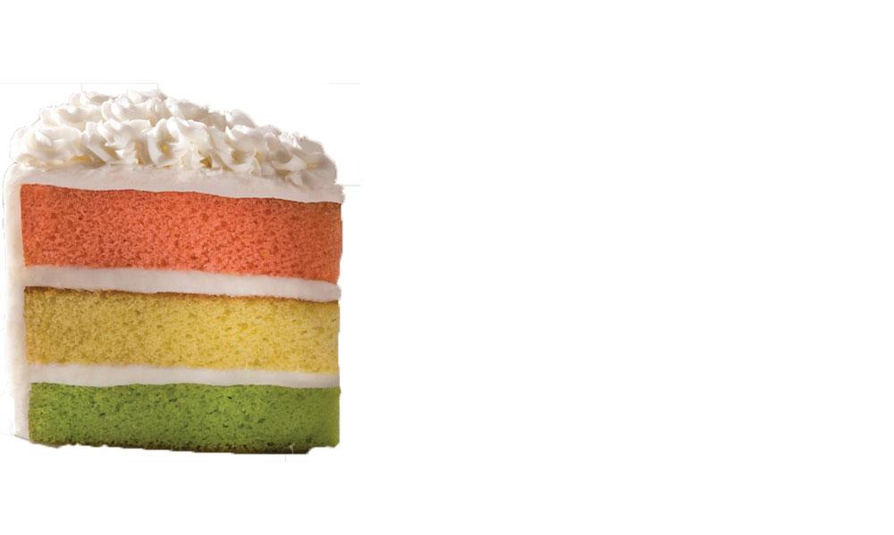
Layers of a Web Page
Every page can be broken down into 3 basic layers
Content Layer -- HTML files (.html)
This is where the content of the page lives. The HTML gives page structure and adds semantics.
Presentation Layer -- CSS files (.css)
The CSS enhances the HTML page with rules that state how the HTML Content is presented. It is best practice to keep as much CSS as possible in separate files.
Behavior Layer -- JavaScript files (.js)
This is where we can change how the page behaves, adding interactivity. It is also best practice to keep as much JavaScript functionality in separate files.

Slide 6
Including files in your HTML
To use an external file, you must link to it (also known as "import" or "include") on your HTML page:
Example of a link to a CSS file:
<link rel="stylesheet" href="path/to/style.css">
Example of a link to a JavaScript file:
<script src="path/to/script.js"></script>
Note that they look similar...but they are somewhat different!

Slide 7

Naming Variables and Functions
There are two hard things in computer science: cache invalidation, naming things, and off-by-one errors.

Slide 8
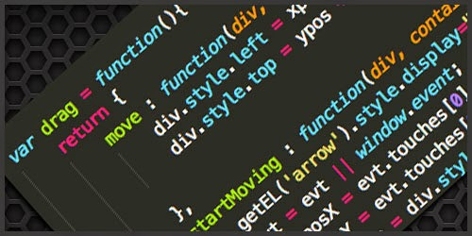
Naming is an art unto itself.
Rules regarding naming variables and functions:
They can only start with a letter, dollar sign ( $ ), or underscore ( _ )
They can also contain numbers, but cannot start with a number
They must not contain a dash ( - ) or a period ( . ) or other symbols
They must not be a reserved word (e.g. "true", "function", "for")
They are case-sensitive ("test" is different from "Test" and "TEST")
Notes:
Make up a few examples of variable names and ask the students which are valid and which aren’t

Slide 9
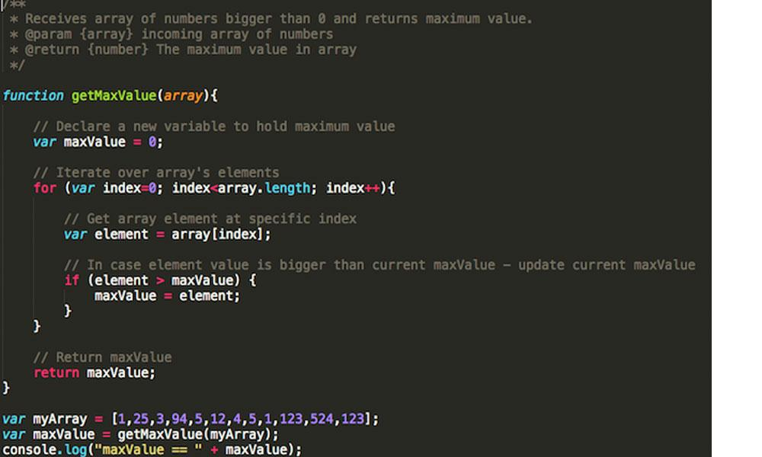
Function Basics
The start of reusable code

Slide 10
Functions have 4 parts:
The function keyword
The function’s name
List of parameters [optional]
The return statement [optional]
function calculateArea( width, height ){ var area = width * height; return area; } var wallOne = calculateArea( 5, 10 ); // 50 var wallTwo = calculateArea( 5, 5 ); // 25
Notes:
Explain what each of these does:
Parameters are where the function can accept incoming data
The return statement is where the function can return a result

Slide 11
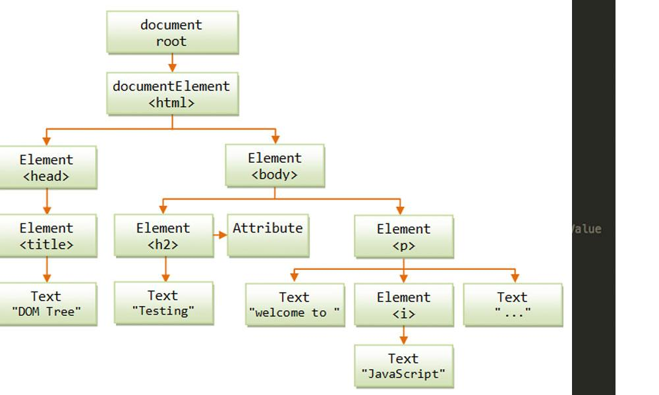
Selecting the DOM
The Document Object Model

Slide 12
DOM stands for the Document Object Model. You can think of this as a representation of the HTML and CSS markup that defines your site.
JavaScript contains several built-in methods to access the DOM and for manipulating it. Here are a couple of the simpler methods for selecting a single DOM element:
document.getElementById();
document.querySelector();

Slide 13
<div id="infoArea"> <p>Some text about something</p> <a class="btn" href="#">Click me!</a> <a class="btn" href="#">Click me, too!</a>
<input type="text" /> <p>Some text about something</p>
</div>
// Examples of how to retrieve various DOM elements:
document.getElementById('infoArea'); // retrieve the one element with the id 'infoArea' document.querySelector('p'); // retrieve the first paragraph tag
document.querySelector('.btn'); // retrieve the first tag whose class is 'btn'
Notes:
Explain that simply retrieving them does nothing; after retrieving a DOM element, you must then access and/or update one of its properties.

Slide 14
Manipulating the DOM
The Document Object Model

Slide 15
<div id="infoArea"> <p>Some text about something</p> <a class="btn" href="#">Click me!</a> <a class="btn" href="#">Click me, too!</a>
<input type="text" /> </div>
// Examples of how to ALTER various properties of DOM elements:
document.getElementById('infoArea').style.backgroundColor = '#e5e5e5';
document.querySelector('p').innerHTML = '<span>Hello</span> World!'; document.querySelector('.btn').innerText = 'Please Click Me!';
document.querySelector('input').value = 'Type something!';

Slide 16
Below are a set of commonly used properties of every DOM object:
Property name | Example of how it is used
style | document.querySelector( 'yourSelector' ).style
style.color | document.querySelector( 'yourSelector' ).style.color
className | document.querySelector( 'yourSelector' ).className
innerHTML | document.querySelector( 'yourSelector' ).innerHTML
innerText | document.querySelector( 'yourSelector' ).innerText
value | document.querySelector( 'yourSelector' ).value // to access a form field’s value

Slide 17

Let’s review
Where does JavaScript fit?
It’s the interactivity of the site. It’s best practice to put your JavaScript in separate files.
Naming Vars and Funcs
Can start with a letter, $, _.
Can contain numbers , just can’t start with a number.
CaSE SensitIVE.
Function Basics
Needs a function keyword. Arguments passed in are known as parameters. Sometimes return a value.
Selecting DOM
document.querySelector(), document.getElementById()

